Slide 1
Arm Slots Revisited
Matt Lentzner

Slide 2
About Me
My main interest is in physical computer simulations. Tried to do a baseball simulation and realized that baseball was not as well understood as I had assumed. Trying to figure this stuff out really caught my interest.

Slide 3
Goal
Qualitatively model how arm angles affect pitching

Slide 4
Easy Quiz
What pitch is the most basic and elemental in a pitcher’s repertoire?
What pitch is typically thrown with the most velocity?
What pitch has the most break?

Slide 5
The Fastball
The reference point for all pitching because it is the most efficient.
Most Velocity
Most Spin
Least Taxing to Throw
Most importantly it is thrown “inline” with the arm. The spin is aligned to the arm slot.

Slide 6
The Thesis
Using a horizontal/vertical scatter plot of pitch movement:
A line drawn from the origin (0,0) to the fastball cluster will describe the arm slot.

Slide 7
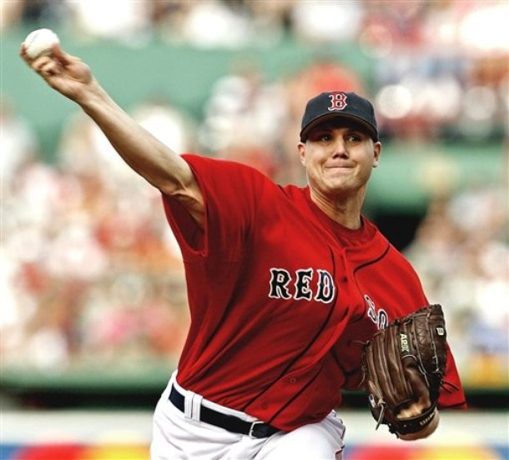
Jonathan Papelbon

Slide 8
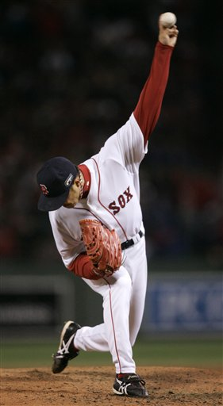
Hideki Okajima

Slide 9
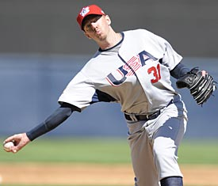
Brad Ziegler

Slide 10
All other pitches work off the Fastball
Cutter (-3 mph)
Fastball (-0 mph)
Splitter (-5 mph)
Change Up (-9 mph)
Slider (-7 mph)
Sinker (-3 mph)
Change Up (-9 mph)
Slurve (-10 mph?)
Curve (-13 mph)
The Pitching Peanut
(high ¾ arm slot)

Slide 11
Is there a practical value to all this?

Slide 12
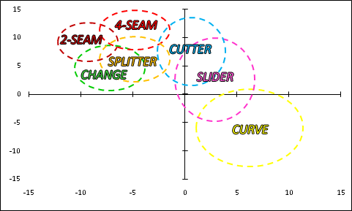
Pitch Typing without Arm Slots (This only works with high 3/4 arm slots)

Slide 13
How you do Pitch Typing using arm slots
Pitch Identification
Use the technique in reverse: know ahead of time what the arm slot is and apply the template
Even pitchers who don’t throw a in game fastball can still be ID’ed once you know the arm slot

Slide 14
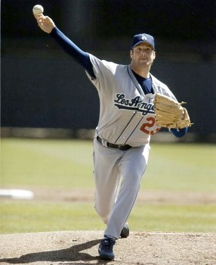
Derek Lowe

Slide 15
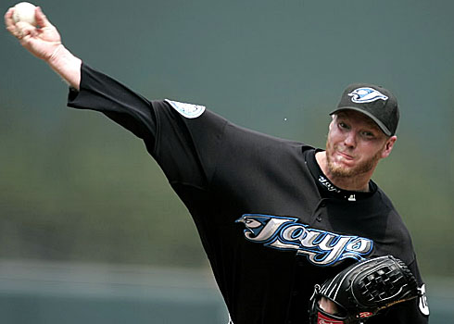
Roy Halladay

Slide 16
Josh Beckett

Slide 17
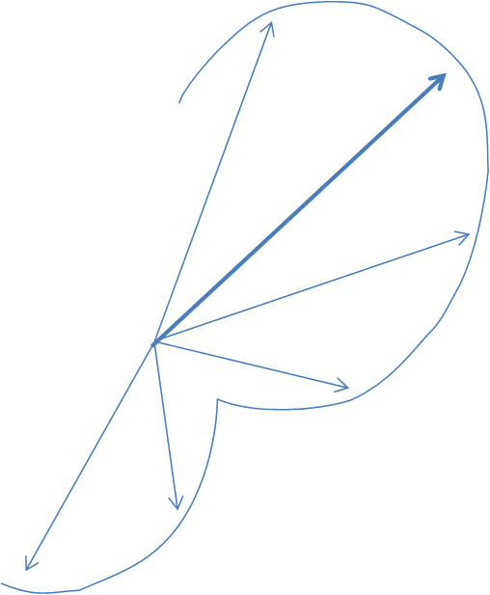
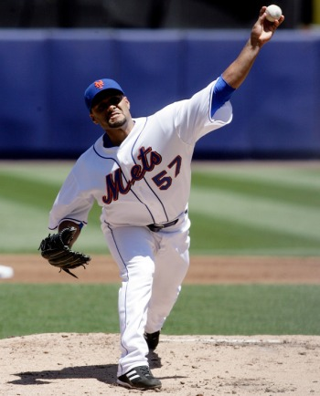
Johan Santana Just Flip the Peanut for Lefties

Slide 18
How to ID Pitches
ID the pitch by offset angle
Yes
No
Is it a fastball, sinker, or changeup?
Use offset ID
Compare pitch speed to determine if a changeup or splitter

Slide 19
Questions?

Slide 20
Spins
Sinker
Fastball
Cutter
Slider
Slurve
Curve

Slide 21
Estimating Arm Slot from PITCH f/x release points (as opposed to scouting it)
Lots of problems
Stride Length
Posture
Position on Rubber (24” wide)
Listed heights (which imply arm length) are not accurate (especially for vertically challenged players)
On the plus side we don’t need high precision

Slide 22
Jonathan Papelbon 6’4”

Slide 23
Brad Ziegler 6’4”

